Slide 1

Notes:
buying a cloud system is a sensible solution - moving to the cloud is inevitable - take advantage of the benefits now
cloud solution is not expensive and NO cost up front. No cash outlayed (first month free if you hate us)
Moving to the cloud is easier than you think

Slide 2

Covid is producing changes
people are more accepting of online
people getting deliveries, embracing the Cloud and not using hardware more and more - on premise is in decline.
Online communication is now more important than ever.
Longer term impacts
Organisations have tried WFH and like it.
Organisations are reviewing their business - downsizing offices and renegotiating leases.
Designing office around the new world.
Notes:
What exactly is it?
How your organisation can benefit from it

Slide 3

What is The Cloud
In the simplest terms, cloud computing means storing and accessing data over the internet instead of your computers hard drive.
What is a cloud phone system?
A cloud-based phone system that connects people through the internet rather than traditional telephone line systems.
How can this benefit your organisation
They can save you money
Keeps you connected with your customers all the time
They are portable
Benefit from advance features
Scalable
Flexible
Latest software version auto updated
Notes:
How you workforce can benefit from a cloud solution
accept and makes calls as they do in the office
turn the service on and off
move between office and home
more efficient use of time
improve internal communication
switch off when not working

Slide 4

Ask yourself this...
Can your team members work the same from home as they do in the office?
Notes:
Have you got the right technology for your business?
If no- what is the right technology options for your business

Slide 5

The Cloud needs internet
To use cloud, in any form, we need good internet. If the internet connectivity is poor, no matter how good the solution itself, the experience will be poor.
Solution
In the majority of cases, the nbn is the solution. 95% of small business solutions are addressed by an nbn service.
Notes:
@Mia - how are we addressing this emphasis on video?

Slide 6

nbn™ - you’ve either got it, or you don’t.
when nbn™ isn’t an option
Mobile data solution for home
Business grade internet for the office
Notes:
Internet - without it, you cannot work from home or have a flexible phone system
We have the nbn which lets Australia have decent internet at decent cost. Functioning internet solution. Embrace it.
No nbn? A mobile data solution for the home
Business grade internet for the office
Show of hands which organisations are already on nbn? If noone - talk about whats the process of moving.
whats available and whats not. If that is unclear lets have a chat. Relevant for your business and workers at home.

Slide 7

Handsets - what are your options
Wifi handset
Pros
Not locked in
Scalable
Economical
Semi-portable
Sustainable (Yealink)
No charge for making calls
Flexible - literally
Cons
Dependant on wifi
Cable handset
Pros
if WiFi is not reliable, a cable ensures good quality internet and calls
Less expensive handsets when cabling is in place
Addresses some people’s concern that WiFi is not reliable.
Cons
If cabling not available the phone wont work -
Fixed to one spot
No handset
Mobile - not locked in
Bria
Pros
No additional hardware
Portable
Software based only
Cons
Relies on mobile phone or laptop being available
Features are similar but not the same as the handset
Notes:
Cable handsets = not good for health if you have to sit near modem
wifi is better they can sit anywhere at home
no handset is even better - bria - DC to talk about benefits
workforce benefits and customer experience benefits

Slide 8
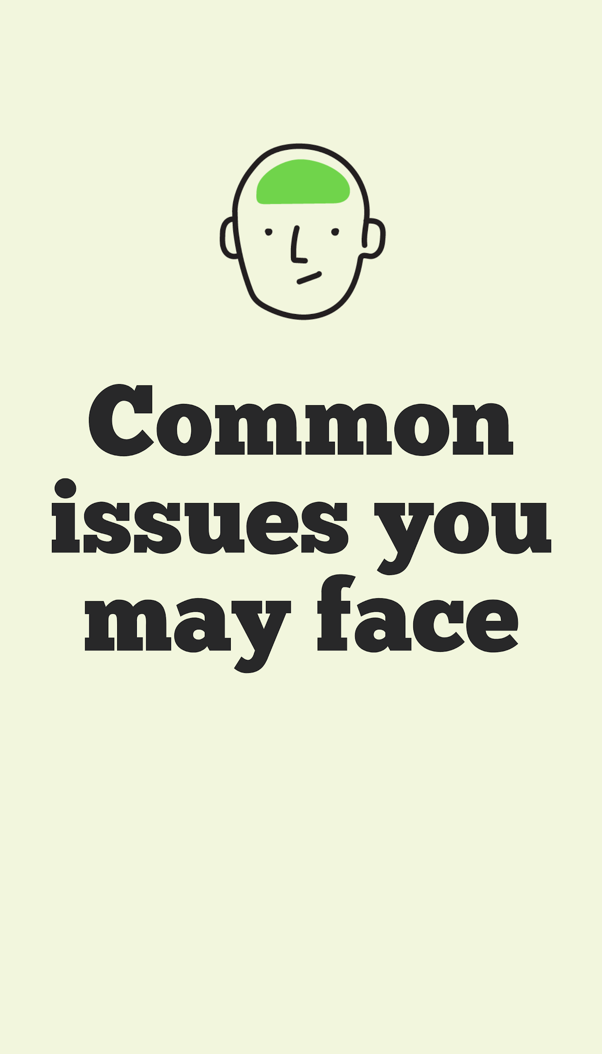
Case study 1
“My workforce operates partly at home and partly in the office nowadays. They need their handsets to work and route calls like they do in the office.
Some teams have video calls with members of staff who are operating from home, how can technology help facilitate these meetings.”
Solution
What you need
Phone system that works wherever you do
WiFi
Features and functionality
3 way calling
Business continuity .
Notes:
@Mia - how are we addressing this emphasis on video?
Solution
The cloud phone system works wherever you work. Once you unplug in your office and plug in at home it will operate exactly the same. All you need is internet access
Its features include 3 way calling and speaker, so you can easily add new callers in for conversations with multiple people in meeting both off and on site.
These phone systems allow for business continuity, if you change the way you operate, this solution allows business to operate as usual.

Slide 9
Scenario 2
“We are a small business who does not have a dedicated IT support person.
Sometimes there is a fear towards changing technology.
Who would be expected to managing implementing a cloud phone system and how would you understand our needs?”
Solution
Getting started is easy.
What is required
Copy of bill
Call flow
Recordings
What is not required
IT technician
What is available
Onboarding Specialist
7 day technical support
What is the process
Let me explain
Notes:
Solution
Firstly we speak in plain English and will explain everything in layman's terms, avoiding the telco jargon.
We hand hold through the onboarding process and only ask you provide us with 3 things which are easy to attain.
Copy of bill
Call flow
Recordings
When we have this information, we configure the handsets so you can plug in and go, no IT technician is required and we have 7 day technical support to walk you through.
Plus, with all your telco on 1 bill, it takes the strain off finance team.
1. make sure your internet is working properly
2. Make sure the type of handsets matches the office requirements
2 Check call flow works on dummy numbers according to the way you want them to land in office
4.

Slide 10
Scenario 3
“The market is saturated with different telcos offering cloud products, how do I know which one to choose and for the price?”
Solution
What to avoid
Hard sell
What to look for
Best intentions
Free bill analysis
Consultative approach rather than being told what you need
Notes:
Solution
Avoid the hard sell telcos and consider one who has your best interests at heart.
We offer a free bill analysis and often we find a cost reduction to be made. Although savings are also found from indirect efficiencies.
We measure our business on what we contribute to charity rather than what we sell. What we will offer is a free consultancy ie what you should be doing in your circumstance.

Slide 11
Scenario 4
“Our staff operate 60% in the field, and 40% behind a desk (mix of office and field).
Why don’t we just supply them with a mobile?”
Solution
Mobile only solution is not a comprehensive solution.
Use mobile to compliment the office cloud phone system.
SIM-only plans are inexpensive.
Notes:
It's likely that 40% behind a desk will be for your staffs’ admin tasks, which is when a cloud phone system is really import as it allows them to
stay connected.
We would recommend you supply them with both a mobile and handset. Our data packages come with up to 65gb.

Slide 12

Is your internet sufficient enough to enable your transition to the cloud?
Is your current handset wifi enabled?
Do you need additional flexibility to route work calls to mobile and PC devices?

Slide 13
Moving to the Cloud - a step by step
1) Select a hosted voice solution
as the right option
4) Ensure the right internet supply
5) How will calls come into the business and how are they distributed
2) Decide on provider
3) Understand what you require in terms of handsets and other equipment
6) Agree installation timing and process to minimise business interruption

Slide 14


Who we support
Asylum Seeker Resource Centre
Burn Bright
ChildFund Australia
Drought Angels
HeartKids
Greening Australia
OzHarvest
National Breast Cancer Foundation
Sleepbus
Save-a-Dog
YOU
Who we are
We are the telco built for the NFP industry
What we do
Cloud phone systems
Business nbn
Resi nbn
Mobile
How we are different
We donate 50% of our profits to good causes
How we are the same
We use the same network as all the big telcos, meaning we are good as the best. We just choose to share our profits differently.

Slide 15


