Slide 1
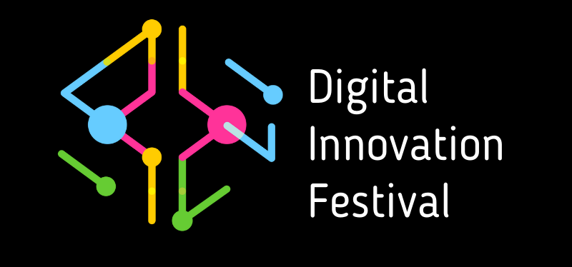
to keep data safe
Cybersecurity essentials
Marise Alphonso with Marcus Harvey, August 2021

Slide 2


We acknowledge the traditional custodians of the land and pay our respects to Elders past, present and emerging.

Slide 3
Agenda
Digital Transformation Hub – overview
Current cyber security landscape
An overview of cyber security practices organisations should have in place
Top cyber security incident entry points
Phishing – real life stories
Key takeaways
Useful resources

Slide 4
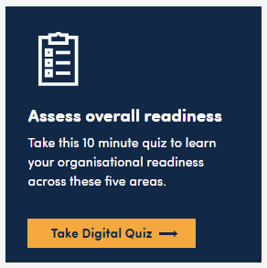


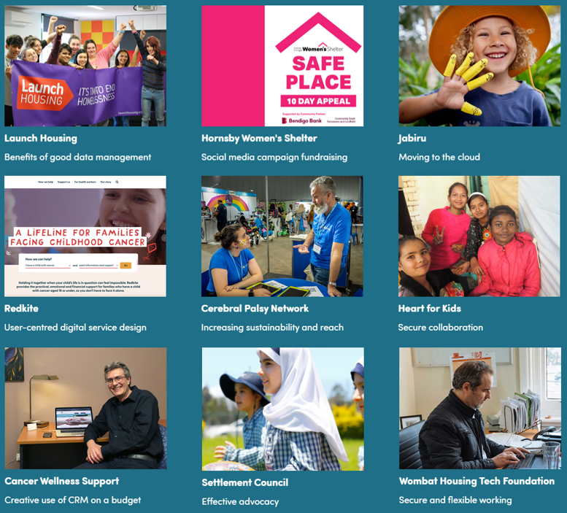

Digital Transformation Hub
Technology to transform non-profit operations
Digital Guides
Expert advice
Technology
discounts
for
not-for-profits
Training resources
Case studies

Slide 5
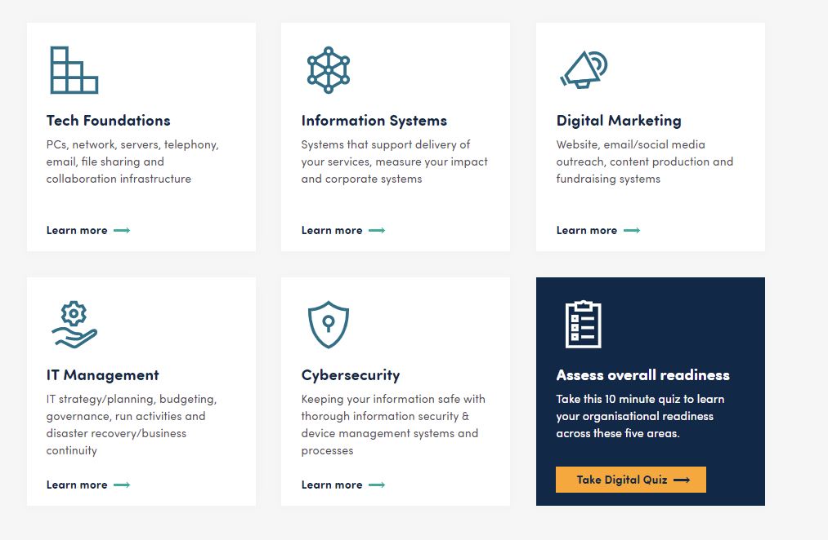
Five domains structure the technology jungle

Slide 6
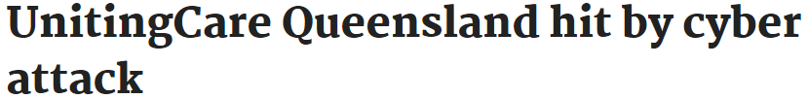
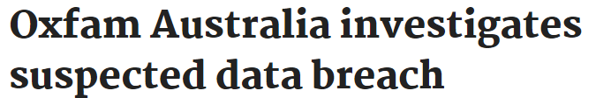




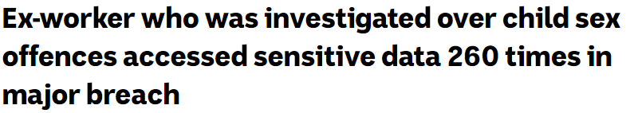

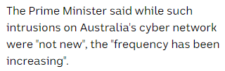

Security in the headlines
April 2021
Feb 2021
Source: https://www.itnews.com.au/news/unitingcare-queensland-hit-by-cyber-attack-563812
Source: https://www.itnews.com.au/news/oxfam-australia-investigates-suspected-data-breach-560690
Jan 2021
March 2021
Source: https://www.abc.net.au/news/2021-03-13/former-contractor-accessed-vic-government-child-data-260-times/13243230
Source: https://www.abc.net.au/news/2021-01-11/australians-turning-point-on-cyber-security-cyberattacks-crime/13018884

Slide 7
Some recent statistics
The OAIC received 539 notifications under the Notifiable Data Breaches scheme in the reporting period July – December 2020. This is a 5% increase compared to the previous 6 months and a 2% increase compared to the same period in 2019.
(Source: Office of the Australian Information Commissioner, NDB statistics July – December 2020)
Australians reported 444,164 scams and over $850 million in losses in 2020, according to the latest ACCC Targeting scams report.
A quarter of all scam reports involved the loss of personal information, up from 16% in 2019.
(Source: Office of the Australian Information Commissioner, Information Matters June 2021 edition)
So far this year scammers have stolen more than $7.2 million from Australians by gaining access to home computers, an increase of 184% compared to the same period last year. ACCC’s Scamwatch, indicates almost 6,500 Australians have reported phone calls from scammers trying to convince them to download software that gives access to home computers and their bank accounts.
(Source: https://www.scamwatch.gov.au/news-alerts/computer-takeover-scams-on-the-rise, 12 July 2021)

Slide 8
Key message
The human element plays a significant role in the successful delivery of security in today’s organisations.
Security behaviour is greatly influenced by you and your perception of risk. These perceptions can be changed.
(Adapted from: Awareness is only the first step, https://www.riscs.org.uk/wp-content/uploads/2015/12/Awareness-is-Only-the-First-Step.pdf)

Slide 9
Your organisation should have protection at these layers…
Cloud apps
Internet
IT Network
Computing devices e.g. servers, laptops, tablets, smartphones
Applications
Data

Slide 10
Data protection
Internet
Network
Computing devices e.g. laptops, tablets, smartphones
Applications
Where to store organisational data so it is backed up
Handling information of a confidential nature e.g encrypt it before emailing, do not store on removable media such as USBs prior to approval
How to handle physical documents with information e.g. shred prior to disposal, do not leave documents with personal information on desks
Data

Slide 11
User access security
Internet
Network
Computing devices e.g. laptops, tablets, smartphones
Applications
Data
Length and composition of passwords/passphrases
Multi-factor authentication: the practice of using a password/passphrase and another factor to log into a user’s account. Examples of additional factors include those provided via Google Authenticator or Microsoft Authenticator
Do not reuse passwords across user accounts
Change your password if it has been compromised
Not to share passwords with other staff. If this cannot be avoided ensure the password is shared only with those who need it, there is an understanding of who is using the account with the shared password and the password is changed if someone who knows it leaves the organisation.

Slide 12
Computing device and network protection requirements
Internet
Network
Computing devices e.g. laptops, tablets, smartphones
Applications
Physically protect your device
Lock your screen when device is left unattended (Ctrl + Alt + Del; Win + L)
Do not install or use unauthorised software
Keep devices up-to-date
Expectations on the use of Bring-Your-Own-Device (BYOD) to access and store organisational data e.g.
  must be PIN/passcode/fingerprint protected
  must never store personal information about clients
  keep devices and installed apps updated
  install antivirus software
  have remote wipe capability to be used if lost or stolen
Network security: firewall configurations, secure network protocols, anti-malware software, VPNs for remote access, wireless network configuration, email filtering
Data

Slide 13
Security incident reporting
Internet
Network
Computing devices e.g. laptops, tablets, smartphones
Applications
Data
Security incidents are adverse events which pose a threat to
an organisation’s information systems and services
Important to have a contact point for staff to report potential security incidents (e.g. IT Support) such as:
Any unfamiliar activity on their devices
Disclosure of information to unauthorised person
Lost devices, removable media with organisation’s information
Unescorted person on office premises
Lost or stolen physical access cards

Slide 14
Email, Internet and Social Media use
Internet
Network
Computing devices e.g. laptops, tablets, smartphones
Applications
Data
Important advice for staff includes:
  Beware of phishing emails
  Use organisational email and the Internet responsibly
  Act responsibly when using social media sites such as Facebook, Twitter, LinkedIn
  Organisational information must not be sent via unauthorised messaging platforms

Slide 15
Top security incident entry points
Phishing: email sent to users with the purpose of tricking users into revealing personal information or clicking on web links. Could also be via voice calls, instant messaging apps, SMS
Ransomware: malicious software installed on machines causing data to be locked up and inaccessible. Could be installed by clicking on links in phishing emails or by gaining access to an account
Use of stolen credentials: usernames and passwords stolen from online services and then used to gain access to user accounts
Misconfiguration: e.g. user access not removed when it must be
Misdelivery: information of a sensitive nature (e.g. personal information, organisation’s confidential information) sent to unintended recipients
Source: Verizon 2021 Data Breach Investigations Report, May 2021

Slide 16
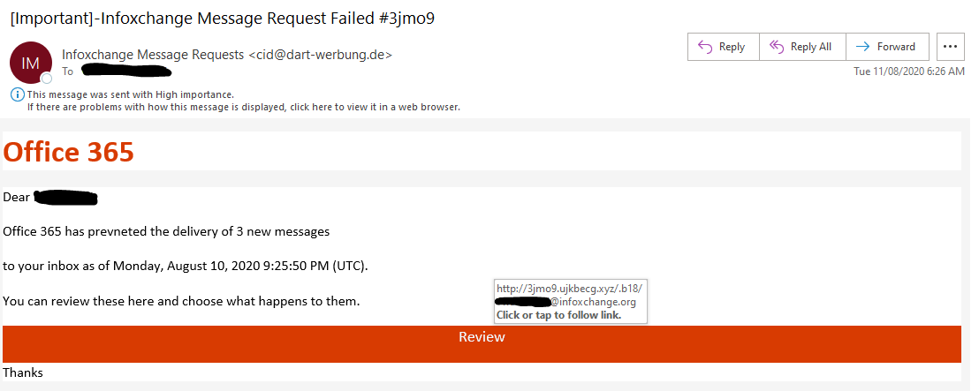
Real life stories - phishing
Staff member received this email about messages that could not be delivered
Clicked on the ‘Review’ button. Was presented with a what looked like a standard MS SharePoint login page with their username already filled.
They entered their password and clicked login
Fortunately, Multi-factor authentication is employed and account access was blocked
The staff member was still asked to change their password

Slide 17
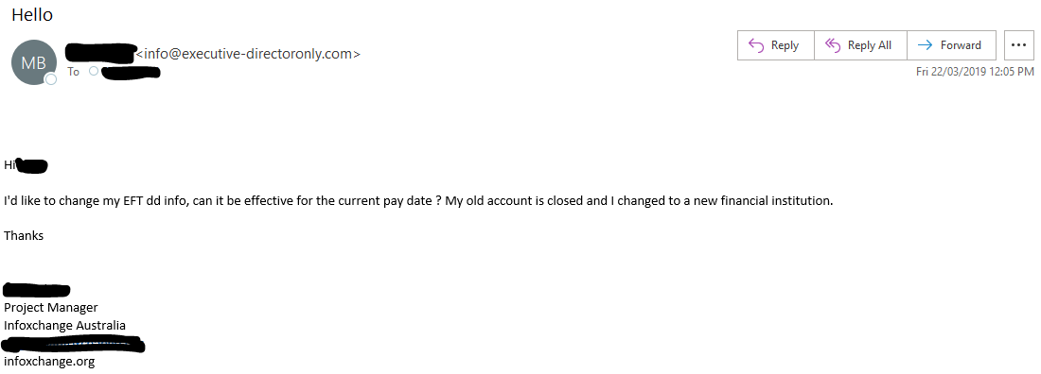
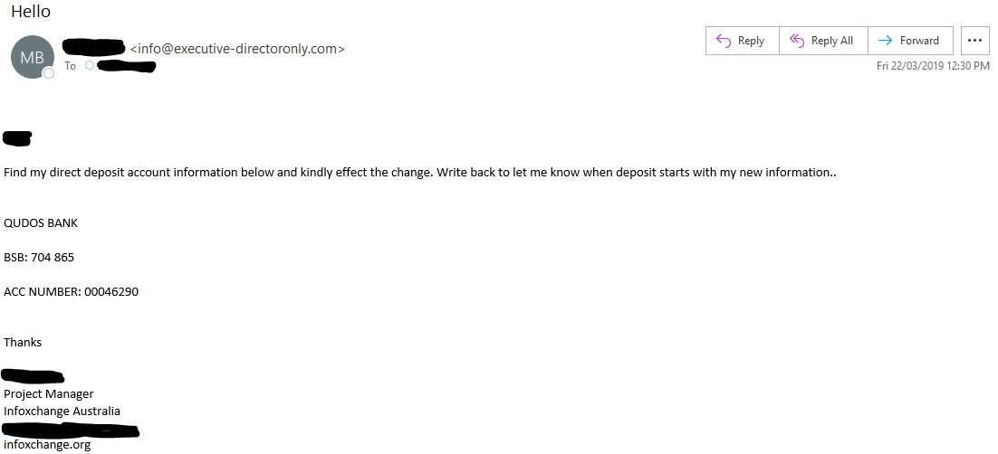
Real life stories - phishing
Email request to change bank account details received by payroll department, signed off from a staff member
Payroll department responded requesting new bank details and not noticing the ‘from’ email address
The second email was received by payroll at which point, due to the grammar in the email they realised this was not legitimate

Slide 18
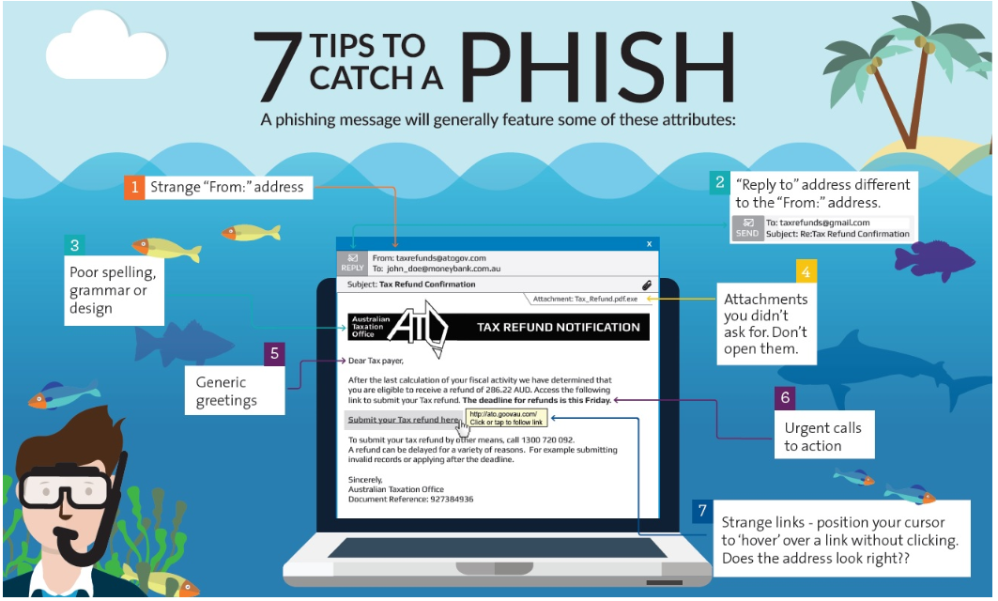

Slide 19
Poll question: Have you been affected by data theft or IT system compromise?

Slide 20
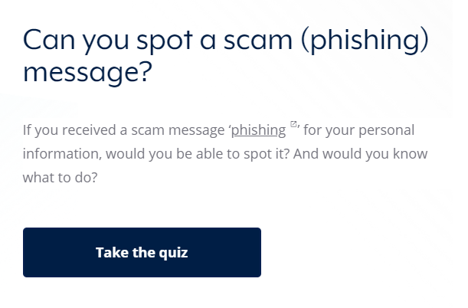
Can you spot a ‘phish’?
https://www.cyber.gov.au/acsc/view-all-content/programs/stay-smart-online/scam-messages

Slide 21
Some organisational processes requiring a security lens
Finance:
  Ensure delegations of authority are appropriate and reviewed regularly
  Ensure that for large amounts of spend, double signatures are required
  Verify change of bank account details via alternate channels e.g. request made via email, use phone call to verify
HR:
  Make sure on-boarding and off-boarding activities are conducted in a timely manner and are holistic i.e. if you use software provided by third parties, remember to off-board as required e.g. Training software packages; Financial management software packages, Car and or Resource booking etc.
  Conduct security awareness refresher training regularly
  Ensure your organisation takes a grateful approach for reports of lost or potentially stolen devices, rather than a punitive one.

Slide 22
Key takeaways to stay secure
Multi-factor authentication for each of your core systems
  An extra layer of protection for core systems is critical to securing access
  Use strong passwords/passphrases that are unique for each account i.e. do not reuse these
User Education
  Exercise caution with emails you receive that ask you to click on web links, open attachments or provide information
  Never respond to emails requesting your personal, financial information and passwords
  Email addresses can be ‘spoofed’ and appear to originate from people you know. Be on the lookout for any requests you receive via email
  Remember fraudsters can create websites that look like the real supplier or banks to capture your information. Do not log in to a web page that you have reached through a link in an email
Essential Eight
  Eight core technical security measures recommended by the Australian Cyber Security Centre to protect your organisation against a range of risks
Make cybersecurity risk management and governance a priority
  Have the conversations on prioritizing cybersecurity within your organisation
  Provide IT security policies for your organisation which should outline how to keep devices and information safe
  Have a contact point for staff to talk to if they’re not sure about an email they receive, or experience unusual activity on their device
Source: https://digitaltransformation.org.au/guides/cyber-security/cyber-security-essentials-where-begin

Slide 23
Useful resources
Hub cybersecurity resources: https://digitaltransformation.org.au/guides/cyber-security
Cybersecurity: what it is & why it matters: https://digitaltransformation.org.au/guides/cyber-security/cyber-security-what-it-why-it-matters
Template end user security policy: https://digitaltransformation.org.au/guides/cyber-security/diy-end-user-security-policy
IT security policy: will be available on the hub in Q4
Cybersecurity fundamentals for NFP staff: https://www.connectingup.org/events/webinars/can-you-spot-phishing-email
Privacy guidelines: https://digitaltransformation.org.au/guides/cyber-security/privacy-guidelines-not-profits
The 5 Knows of cybersecurity:
https://www.telstra.com.au/content/dam/tcom/business-enterprise/security-services/pdf/5-knows-of-cyber-security.pdf
Report CyberCrime to Australian Cyber Security Centre 'ReportCyber’: https://www.cyber.gov.au/acsc/report
Check if your personal details have been compromised in a data breach: https://haveibeenpwned.com/
Guidance on Identity Theft: https://www.idcare.org/
SANS Security Awareness Tip of the Day: https://www.sans.org/tip-of-the-day

Slide 24
Questions and Discussion

