Slide 1


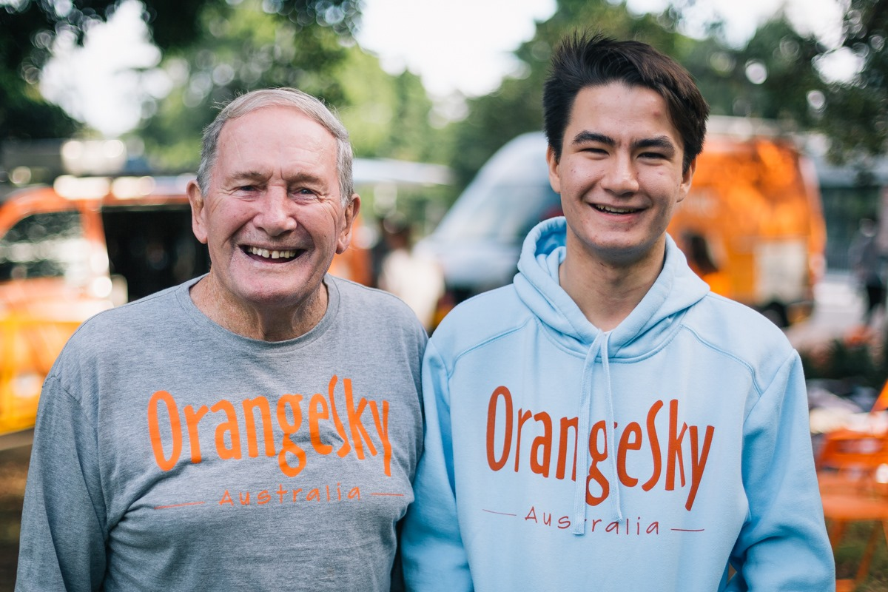


Building the foundations of a Volunteer Management Funnel Process

Slide 2
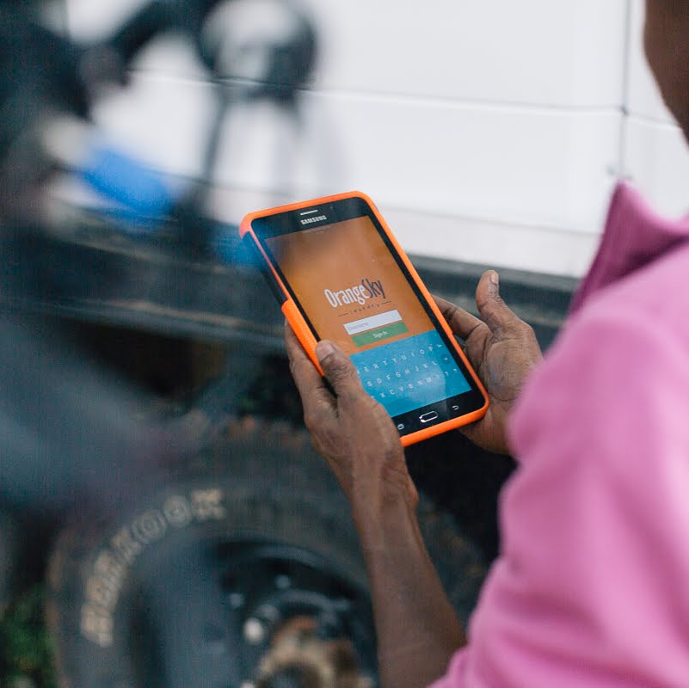
Firstly, Who are we?

Slide 3

Understanding the Challenge first!
Before solutions will be of any use to us - we need to understand the problem we want it to solve…
I need volunteers to help achieve my mission/community goal. And although I love and care deeply for my volunteers, it is extremely time consuming and frustrating to manage them - as (due to external commitments) 90% of them can a times be unreliable and non-committal to the their volunteering duties (typically, because for most volunteers, this is their 3rd or 4th priority in life – e.g. family, work, school, etc.). Without highly engaged and highly active volunteers, I cannot achieve my mission, and thus cannot continue to run my organisation.

Slide 4
Understanding the Process - what are other people saying? (continued)
7.3 hours per week
Key take-ways:
  This is almost 1 day of full time work
  All organisations use multiple platforms to engage
  Majority of this is manual handling, or repetitive admin work
Time spent engaging with volunteers per week
90%
Of organisations engage via phone calls
80%
Of organisations engage via emails
50%
Of organisations engage via SMS/WhatsApp/Facebook/etc.
(Data Source: Orange Sky survey conducted with external volunteering organisations

Slide 5
Understanding the Process - what are other people saying? (continued)
Regarding your volunteer engagement, what do you want to spend less time on?
Admin
Trying to find replacements for shifts not covered
Answering the same questions over and over again
Rostering
Recruitment

Slide 6
Understanding the Process - what are other people saying? (continued)
If you could spend less time on these aspects – what would that mean instead?
More time on the cause (helping people)
The nice parts of volunteer programs like engagement, support, recognition etc.
Participating in more events / areas of the organisation
Writing grant applications
Growth

Slide 7
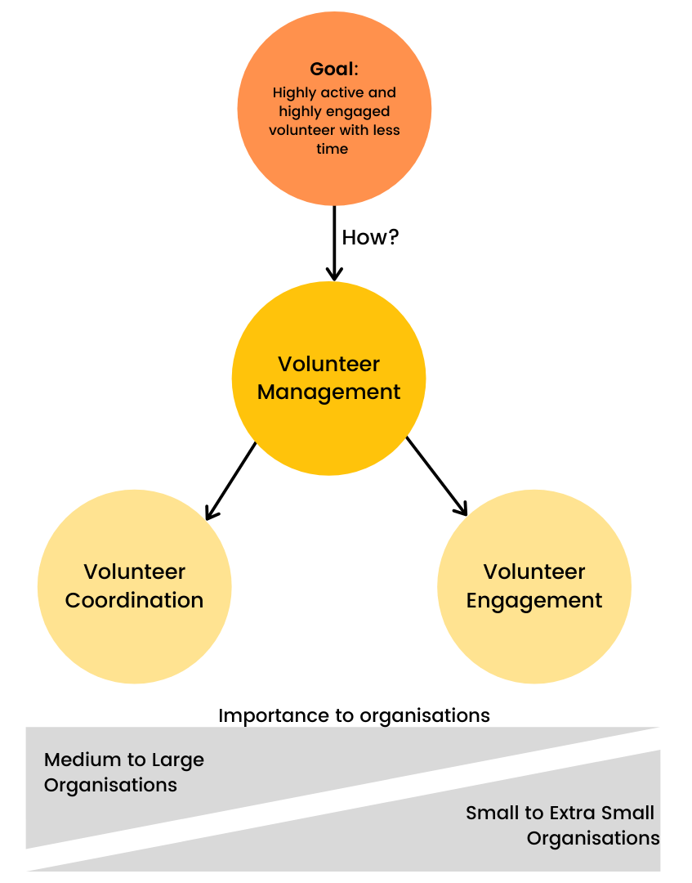
What does this mean?
Key Feedback
Coordination can be automated easier (i.e. tech)
Engagement can be complex and difficult to automate
Both are important and rely on each other to be effective
Art vs. Science
Management vs. Engagement vs.
Coordination

Slide 8
What is a Volunteer Funnel?
Referrals system?
Facebook ads
Digital presence? (SEEK, go volunteer, etc.)
Sourcing Volunteers
100%
< Awareness
< Interest
< connection / rapport
< consideration
< conversion
< advocacy / longevity
80%
Onboarding process?
(long or short?)
65%
Landing pages
45%
10%
EOI
Introduction
conversion
Quality
Volunteers
Onboarding Interested Volunteers
What else can be done at each step?
Most common conversion rate is <10%

Slide 9

What is a Volunteer Funnel? (continued)
EOI
Introduction
conversion
.
Operations & Retention
Stay front of mind
Visibility of the cause
Updates
Reminders of opportunities
Activate, involve & measure
Thank & appreciate
Stay connected
GETTING VOLUNTEERS ON SHIFT
  Rostering
  Peak of excitement
Coordinating efforts on the day
  Who does what?
Collecting impact data
REMINDERS
Collecting feedback
Learning/induction systems
Ease of activity & availability (filling rosters)
Access of information
Making connection always available (e.g. chat, notices, etc.)
Show them the outcome of their work (data collected)
Capitalise on the peak of excitement – reminder of day
Follow up with your appreciation
Connect to next opportunity
Email follow ups
News-letters
Measuring impact of volunteers

Slide 10

What powers this funnel?
PUSH Forces:
Forces that can encourage and motivate new volunteers to apply and become active – hard to maintain long term
Awareness of opportunities (spark interest/awareness)
Motivation from peers or content from the organisations (short burst of energy to take action)
Intrinsic guilt to contribute or “pitch in”
Reminders
Obligations to family/career/community/etc.
PULL Forces:
Forces that intrinsically excite and encourage people to volunteer continuously – easiest to maintain long term
Desire to give back and do more
Nurture their intrinsic purpose
Desire to learn new skills (self improvement)
Alignment to the cause (e.g. saving the environment is extremely important to them)
Fun & Enjoyment involunteers

Slide 11

What restricts this funnel?
Push
Growth of Volunteers
Reduction of Volunteers
Resistance
Pull
Resistance Forces:
Forces that restrict people from volunteering (both internally or externally)
Lack of awareness (I didn’t even know it existed?)
Lack of interest (I don’t know what it is about?)
Not enough time/availability in the schedule
Not a big enough priority to commit to long term
Not easy enough to get involved (or stay involved)
Too inconvenient and complicated to attend
Lack of encouragement / connection
Not aligned to their purpose / beliefs
Not enough opportunities to get involved.
“What am I getting out of this? I have a lot going on in my life and can’t afford to sacrifice time!”
Is your (Push + Pull) > Resistance?

Slide 12


How simple is your process (easy or a complicated?)
Complicated
Level of effort
Thorough
Simple
Awareness & Application
Onboarding Process
Involvement & Retention!
Key Points:
There needs to be a balance of doing our due diligence to make sure all volunteers are screened/checked/approved and making it easy to help (this balance might take time to refine for each org)
Try mapping out each ‘step’ that a volunteer takes to become involved, and see if/where you can streamline this for a better experience.
An unnecessarily complicated/long onboarding and operational process can deter volunteers from joining and staying.
Volunteers can see volunteering as them “doing you a favour”, and as such may not think twice about leaving or being casual about it. By providing value back to them, it balances the arrangement and encourages commitment.
I love to help out when and where I can, but if it’s too complicated or hard to get involved – I usually don’t bother, and maybe just help elsewhere. I just have way to much going on from day to day and don’t have time.
-Anonymous Volunteer, 2021

Slide 13
So how does this look for your current operations?
Ask us for your own Volunteer Funnel Workbook Template!

Slide 14
Thanks for Listening!
Feel free to reach out if you would like to know more
Email: info@volaby.org
Or out website at: https://volaby.org/

